Slide 1
LPV Albedo Focus Area
SALVAL (Surface ALbedo VALidation) tool developed to provide transparency and traceability to the validation process of albedo products

Slide 2
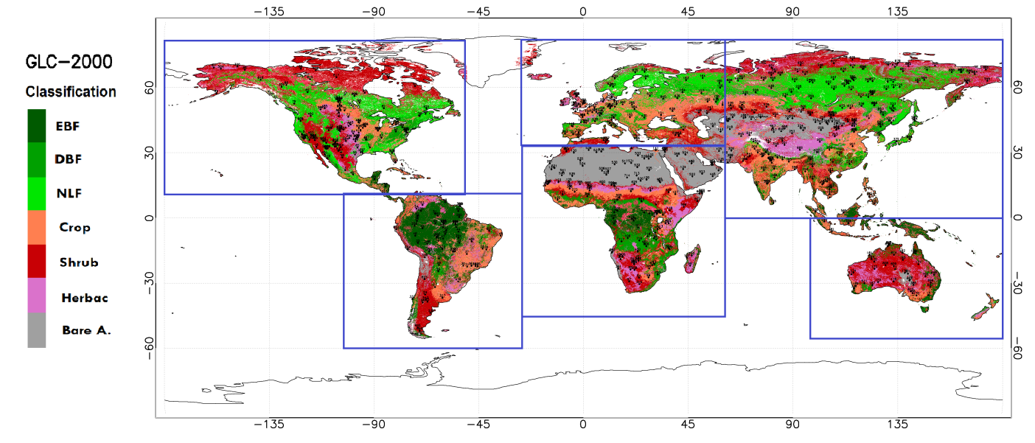
LPV Albedo Focus Area
LANDVAL network of 725 sites proposed based on EUMETSAT SAVS1.0 compilation of sites. Homogeneity criteria applied. 251 sites from BELMANIP2.1.
Criteria of selection
Parameter | Threshold | Purpose
Distance to open water bodies [km] | 5 | Avoid open water bodies and their changing reflectance behavior with viewing geometry
Minimum fraction of majority land cover type at 5 km distance | 60% | Avoid areas with heterogeneous land cover.
Land Cover Majority at 5km | Exclude 'Water bodies' and 'Urban areas'
Vertical range [m] within a distance of 5km | <300m | Avoid areas with significant terrain variability close to a site.
Location (Latitude) | 60ºS to 80ºN | Exclude sites over extreme latitudes, where Global Land products does not provide data

Slide 3
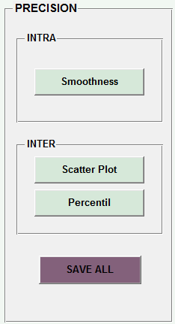
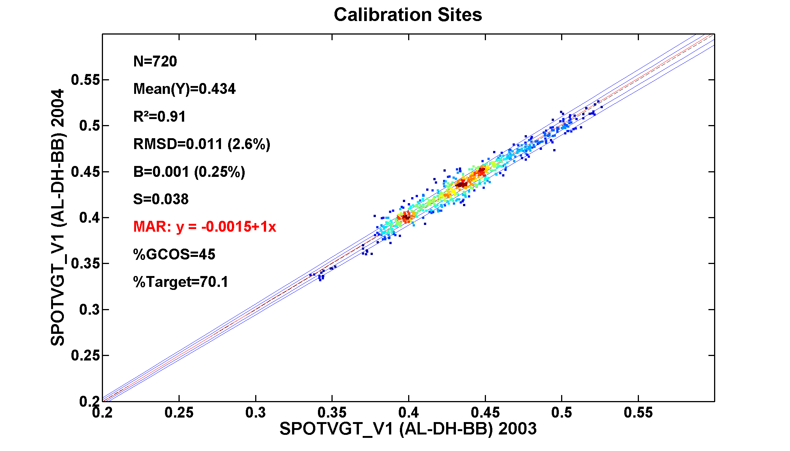
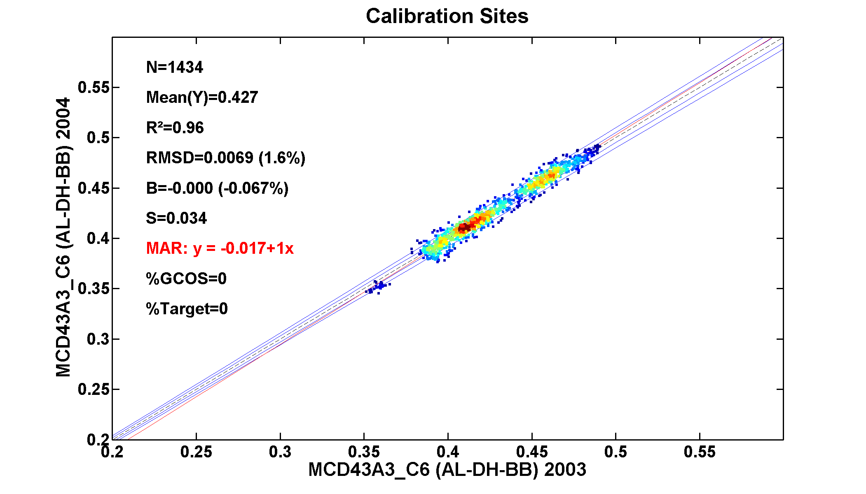
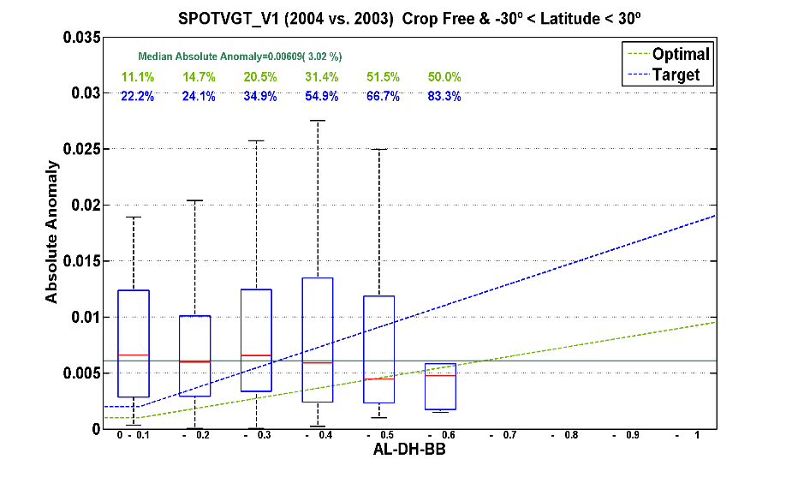
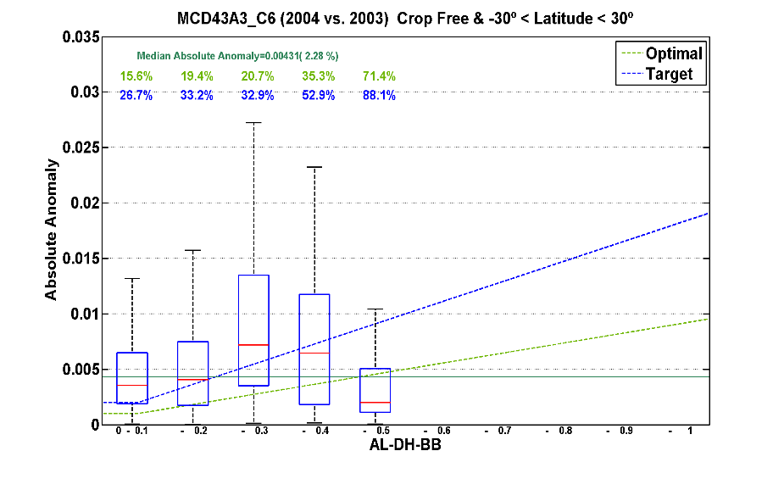
Intercomparison of Albedo products (MODIS C6, GLOPS, ESA GLOBALBEDO, GLASS) with SALVAL tool in progress -- GCOS Action
Metrics and key examples to be included in the Albedo LPV protocol

Slide 4
